Slide 1
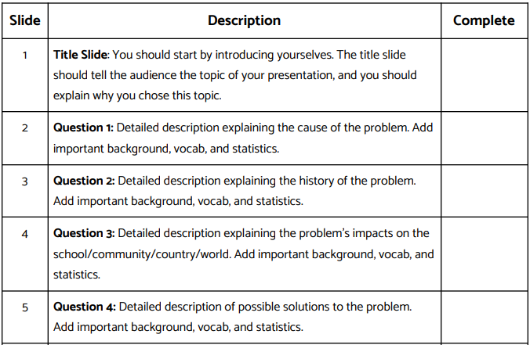

Slide 2
Title of Your Presentation
Include names of students in the group

Slide 3
Quick Intro
Briefly discuss topic or problem
Why you chose it
What it means to you
Your solution

Slide 4
Problem Topic Slide
Discuss problem or topic in more detail than on previous slide
Add visual that illustrates problem.

Slide 5
Who Are Stakeholders Involved In Your Issue & How are They Impacted?
Discuss people impacted by issue you chose.
How are they impacted?

Slide 6
Steps You Took To Learn More About Issue & What You Learned
Discuss your research findings that led you do decide on your action.
What previous actions have been taken?
Were they successful?

Slide 7
Difficulties You Encountered While Completing Your Project & How You Overcame Them
What problems arose during the completion of this project?
How did you deal with or work around those issues?

Slide 8
Solution Slide
Include your solution, objective or action
A visual that illustrates your objective
Talk about your objective in more detail than you did in your quick intro

Slide 9
Your Action & Outcome
Discuss your action
How it was implemented
Outcome.
Was it successful?

Slide 10
Your Group's Reflection
What did you learn while completing this project?
What have you learned about how the "system" works?
What skills, knowledge or understandings could you take with you to college or into your life as an engaged citizen?
What might you have done differently if you were to start this project over?
Overall, how satisfied are you with the outcome of your project?

Slide 11
Questions From Committee
Be prepared to take specific questions from committee members.

Slide 12
